Slide 1
We do not know the future, but we can try and prepare for it.
Through scenarios we can:
Increase our understanding about the future;
Scan potential changes in the environment;
Build consensus for change;
Manage risks.
Maack J.N., Scenario Analysis: a Tool for Task Managers, 2001, World Bank

Slide 2
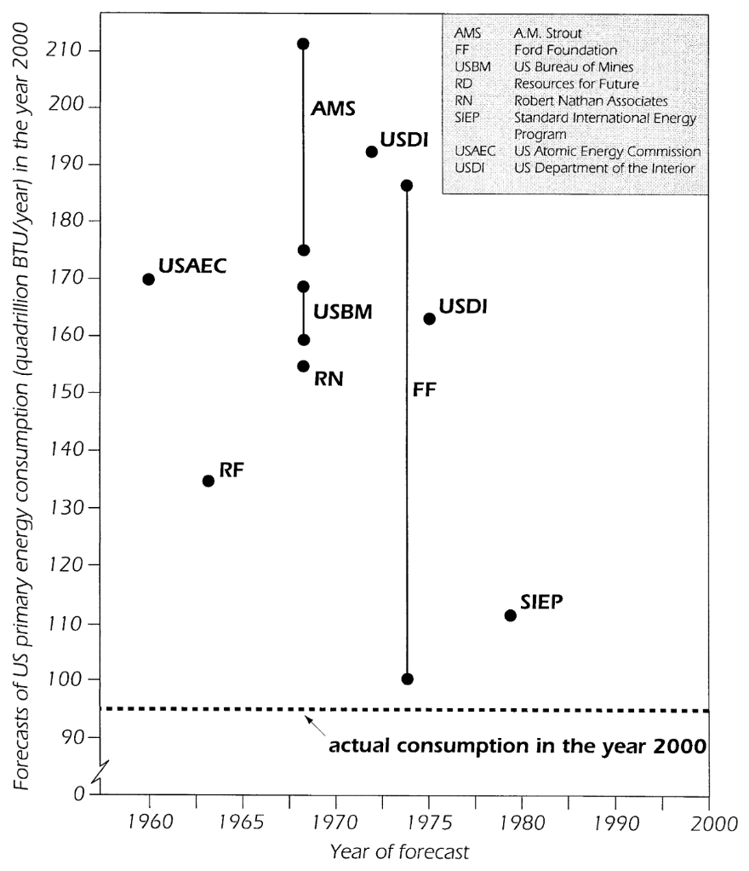
We do not know the future, but we can try and prepare for it.
Through scenarios we cannot predict the future!
﻿
Edison: “﻿I can therefore see no justification for the introduction of [AC current] which has no element of permanency and every element of danger to life and property”
Smil, V. (2000). Perils of Long-Range Energy Forecasting Reflections on Looking Far Ahead. Technological Forecasting and Social Change, 65(3), 251–264. https://doi.org/10.1016/S0040-1625(99)00097-9
Notes:
Technological optimism;

Slide 3
Introduction to scenarios: definition
Scenarios can represent both ‘descriptions of possible future states and descriptions of developments’.
Börjeson L. et al., Scenario types and techniques: Towards a user’s guide, Futures, 2006
They are more than model outputs or inputs. They narrate a whole story, with words and numbers;
They can encompass uncertain elements which are “actor contingent” (e.g. investments) and “non-actor contingent” (e.g. oil prices)
Hughes, N., Strachan, N., & Gross, R. (2012). The structure of uncertainty in future low carbon pathways. Energy Policy, 1–10. https://doi.org/10.1016/j.enpol.2012.04.028

Slide 4
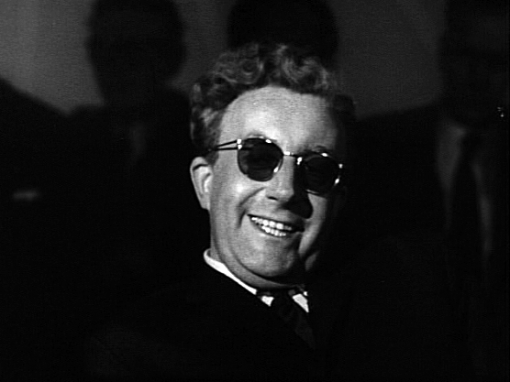
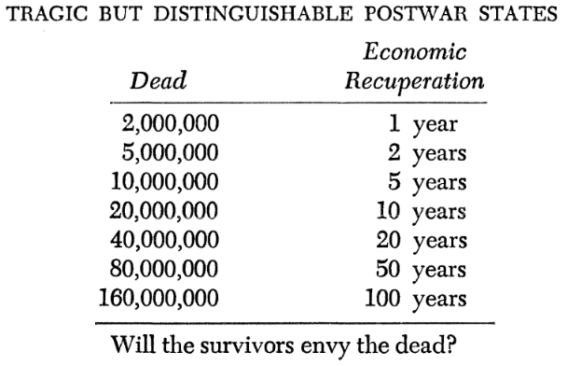
Use of scenarios
Use of scenarios in the modern era arose primarily as part of military strategy exercises.
Emergence of simulation models and subsequent evolution of “systems analysis” led to the adoption of scenario techniques - The Rand Corporation, USA.
The use of energy system models rose following the oil embargo in 1973; the practice of scenario planning rapidly grew during the same period.
By Directed by Stanley Kubrick, distributed by Columbia Pictures - Dr. Strangelove trailer from 40th Anniversary Special Edition DVD, 2004, Public Domain, https://commons.wikimedia.org/w/index.php?curid=11862639
Question! Why do you think scenario planning evolved then?
Kahn, H. (1960). On Thermonuclear War (2nd ed.). New Jersey: Princeton.
Notes:
Formalized use of scenarios in the modern era arose primarily as part of military strategy exercises that aimed at being prepared for different alternatives. The emergence of simulation models and the subsequent evolution of “systems analysis”, eventually led to the adoption of scenario techniques, many of which originate from work carried out by The Rand Corporation in the USA for defense oriented studies. The importance of scenario analysis increases when uncertainty and consequence increases. Just as the use of energy system models rose following the oil embargo in 1973, the practice of scenario planning rapidly grew during the same period

Slide 5
Use of scenarios – managing uncertainty
Scenario assessments encompass major uncertainties:
Iterative approach - technical, behavioral and financial feasibility can be assessed.
Scenario analysis can help in comprehending interrelation of key decision variables.
Formulation of insights to better understand implications of specific policy or investment decisions.
Robust or poor decisions can be identified.
Notes:
The assessment of a set of scenarios that are able to encompass the major uncertainties becomes imperative in energy systems analysis. An iterative approach can be adopted, in which the technical, behavioral and financial feasibility of the model outputs can be assessed sequentially in a range of scenarios. If carried out properly, scenario analysis can help in comprehending how the key decision variables interrelate and affect the system in question. At the same time, based on the outputs, the modeler can formulate insights and better understand the implications of specific policy or investment decisions. In this way, robust or poor decisions can be identified, for instance if they appear recurrently in all scenarios or in just one extreme scenario respectively.

Slide 6
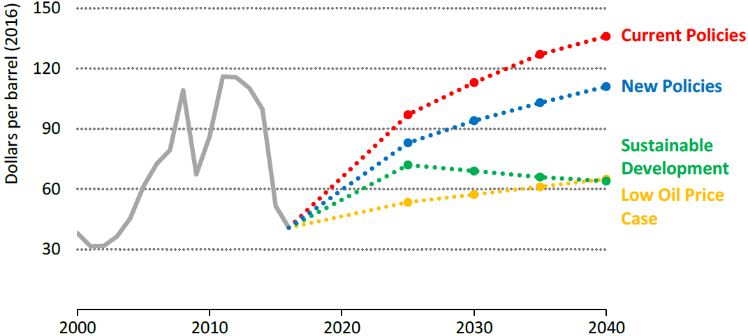
Uncertainty about external phenomena (Oil price)
Source: IEA WEO 2017
Notes:
Oil prices vary widely by scenario, reflecting the different ways in which resources, costs and policies could affect the supply-demand balance

Slide 7
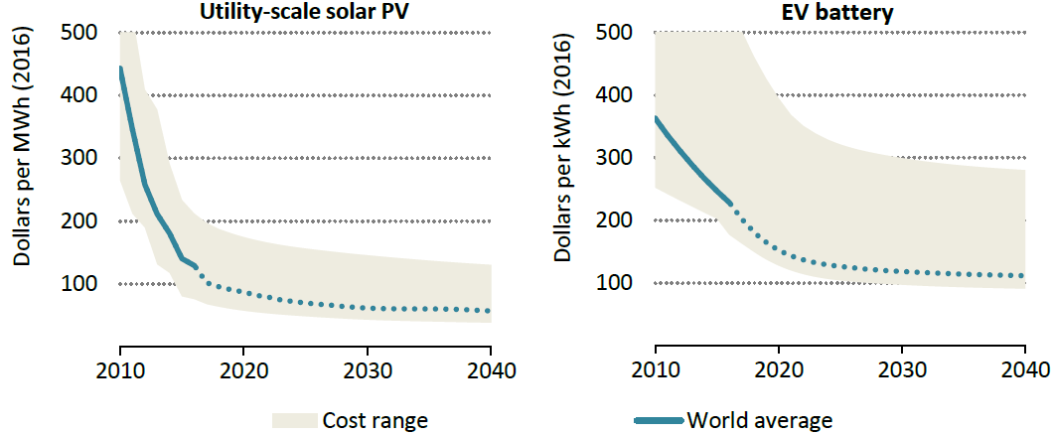
Uncertainty about external phenomena (solar photovoltaics and batteries)
Source: IEA WEO 2017
Notes:
Costs correspond to New Policies Scenario. Reductions in costs of key technologies continue to give strong impetus to the energy transition

